Slide 1
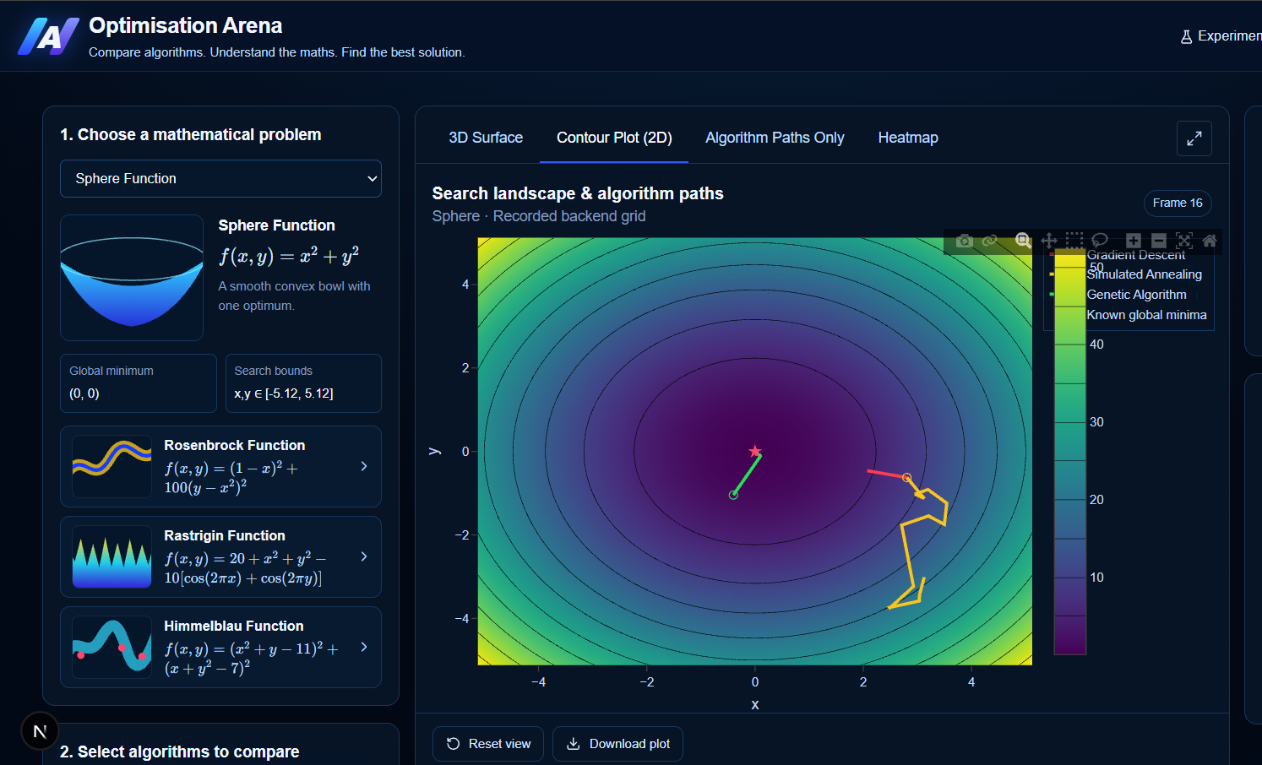
Optimisation Arena
OXHACK 2026 · HRT TRACK
Evidence-based algorithm selection: compare, predict, and verify with real experiments.
Best Use of Data for Predictions and Decision Making
Notes:
Introduce the team and the one-line pitch: Optimisation Arena compares optimisation algorithms on benchmark functions and uses real experiment data to recommend, explain and verify which algorithm to use.

Slide 2
Given a problem and a limited evaluation budget, which algorithm should we choose — and what evidence supports that choice?
THE PROBLEM
Landscape
Dimensions
Budget
What wins on a smooth convex bowl can stall among many local minima.
Behaviour shifts as the search space grows.
Wider exploration often costs more evaluations and compute.
Optimisation Arena · OxHack 2026
02
Notes:
Choosing an algorithm without experimental evidence leads to inefficient or poor optimisation. Performance depends on the function, dimensionality, initial conditions and computational budget.

Slide 3
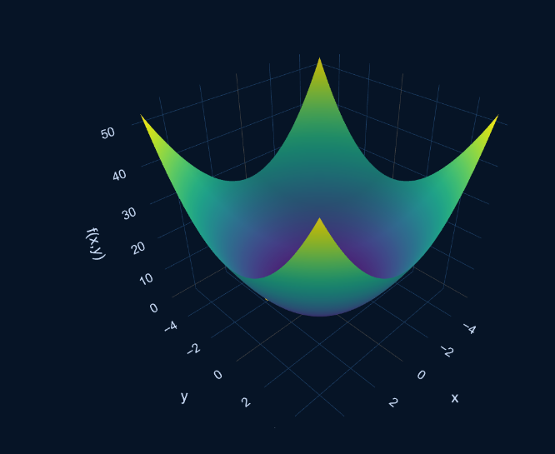
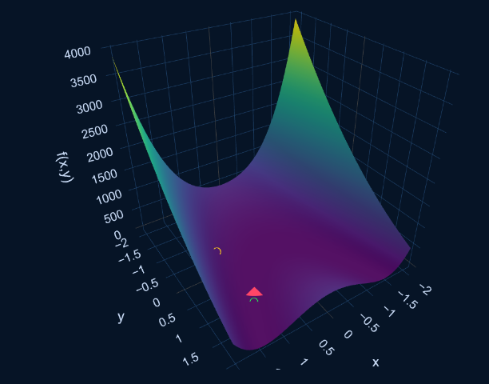
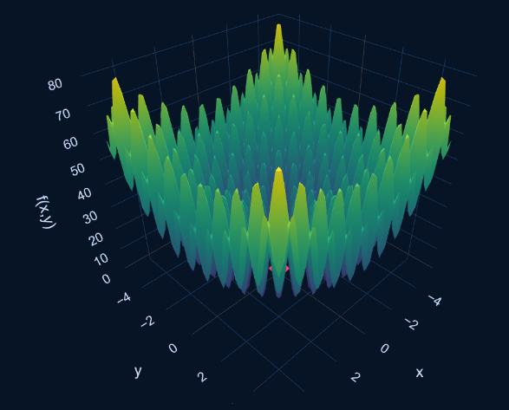
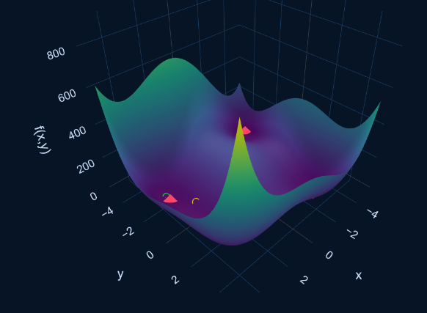
Four benchmark landscapes
THE ARENA
Sphere
Rosenbrock
Rastrigin
Himmelblau
One global minimum. Tests basic convergence.
A narrow, curved valley. Tests navigation of awkward geometry.
Many local minima. Tests exploration and escape.
Several minima. Tests choice between promising regions.
Optimisation Arena · OxHack 2026
03
Notes:
Standard benchmark functions give controlled, repeatable test environments. Objective values let us measure performance quantitatively instead of judging by eye.

Slide 4



Three ways to search
THE COMPETITORS
Gradient Descent
Simulated Annealing
Genetic Algorithm
Follows the gradient downhill. Fast on smooth landscapes; sensitive to start point and learning rate.
Stochastic moves that sometimes go uphill, giving a chance to escape local minima.
A population evolves through selection, crossover and mutation.
Fair fights: same objectives, comparable evaluation budgets, repeated random seeds.
Optimisation Arena · OxHack 2026
04
Notes:
Each algorithm has strengths and weaknesses. The arena runs them on the same problems under comparable conditions so the comparison is fair.

Slide 5
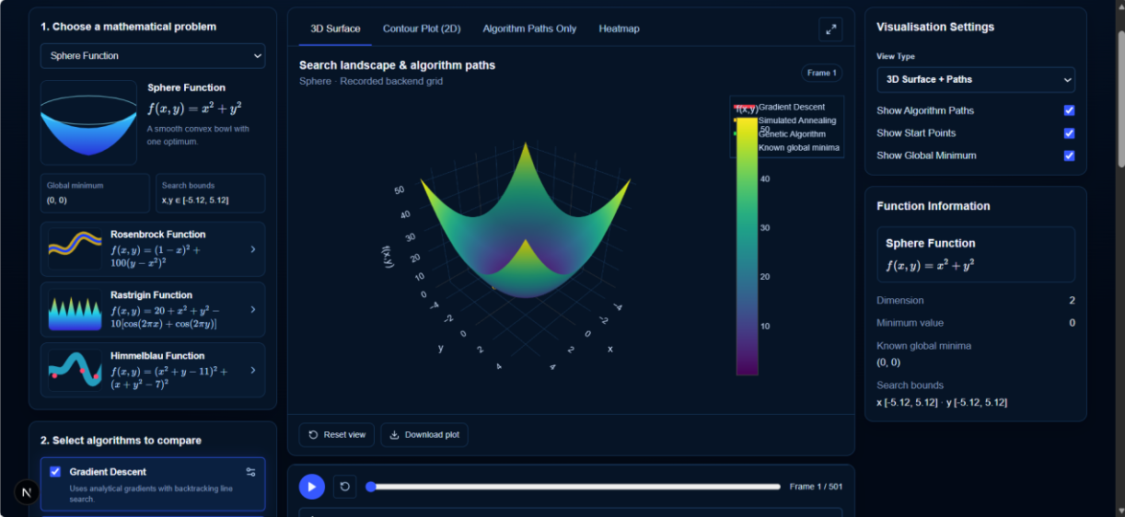
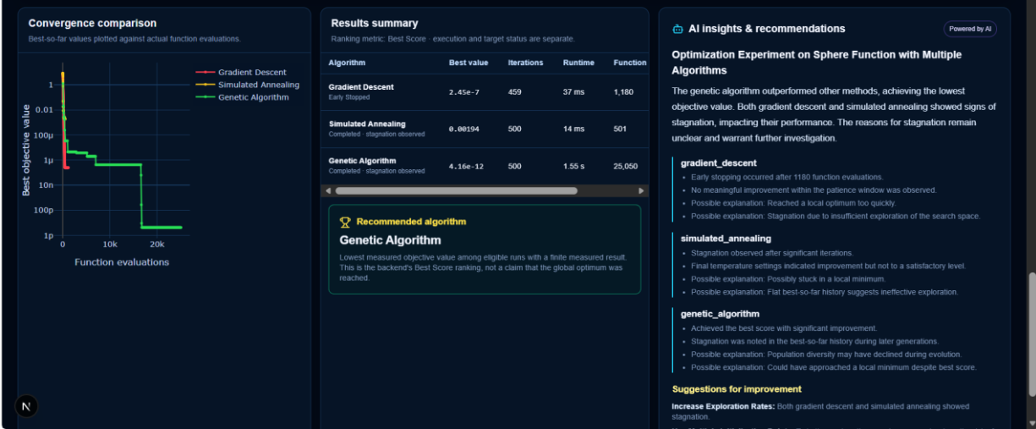
See the search happen
BUILT AND WORKING
Interactive Plotly views show:
The shape of each objective function
Each algorithm’s path through the search space
Objective value over time
Convergence compared side by side
Optimisation Arena · OxHack 2026
05
Notes:
The core dashboard is already built: a dark, scientific interface with Plotly landscape plots and convergence charts. Walk through a screenshot or switch to the live app here.

Slide 6


Intelligent Algorithm Selector
THE ML EXTENSION
INPUTS
Benchmark function
Recommendation
Number of dimensions
Decision tree
Predicted algorithm plus the decision path that explains it
Trained with scikit-learn on real experiment records
Evaluation budget
The model learns from historical runs, recommends an algorithm, then gets tested against real outcomes.
Optimisation Arena · OxHack 2026
06
Notes:
This is where the project fits the HRT category: measured experimental data becomes a prediction that can be checked against a real outcome. The model is loaded for inference, not retrained on each request.

Slide 7
The training pipeline
FROM RUNS TO A MODEL
01
02
03
04
Load real experiment records
Validate and prepare the data
Label the winner: lowest final objective, seeds aggregated
Split train and held-out sets by configuration
05
06
07
08
Train and save the tree with its preprocessing
Evaluate on held-out data
Compare with a simple baseline
Serve predictions through the backend API
No fabricated outcomes or labels: every record comes from the arena’s own experiment engine.
Optimisation Arena · OxHack 2026
07
Notes:
Splitting by configuration stops near-duplicate runs of the same problem from leaking into the test set and inflating accuracy. The preprocessing is saved with the model so training and prediction use identical transformations.

Slide 8

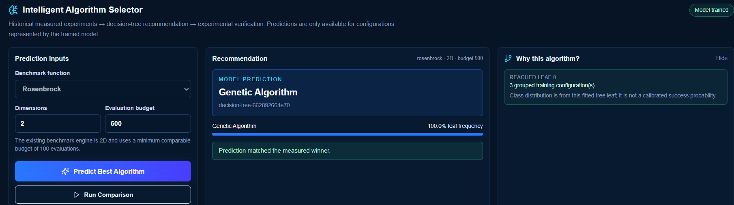
Predict, run, verify
END TO END
01
02
03
04
05
Set function, dimensions, budget
Tree predicts and explains
Run all three algorithms
Measure the actual winner
Compare predicted with actual
Optimisation Arena · OxHack 2026
08
Notes:
The actual winner is decided with the same objective definition used to create the training labels, so prediction and verification are directly comparable.

Slide 9
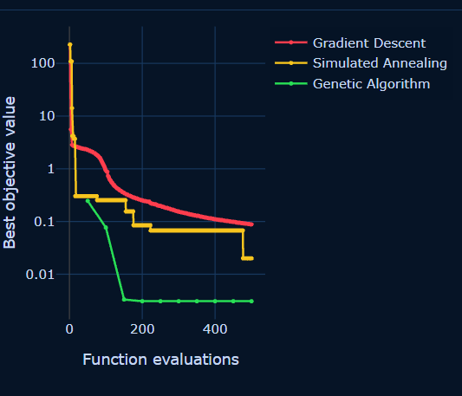
Did the prediction hold?
LIVE VERIFICATION
Predicted
Genetic Algorithm
Observed winner
Genetic Algorithm
Final objective
[__]
Evaluations · runtime
[0 · 33 s]
Optimisation Arena · OxHack 2026
09
Notes:
Fill the bracketed values from a real run before presenting, or switch to the live demo here. Never present example values as live predictions.

Slide 10




What the evidence supports
SCIENTIFIC HONESTY
No leakage
Known functions only
Near-duplicate runs never span train and test.
New runs of four benchmarks are not new functions.
Scores, not probabilities
Says when it can’t tell
Tree scores are not calibrated chances of success.
Too little data means no recommendation, not invented confidence.
Optimisation Arena · OxHack 2026
11
Notes:
A model is not reliable just because it was trained. These safeguards are what make the predictions credible to judges looking for good use of data.

Slide 11
An evidence-based decision loop for choosing algorithms
WHY IT MATTERS
Optimisation
Experiments
Data
Predictions
Explanations
Verification
Optimisation Arena · OxHack 2026
12
Notes:
The differentiator is the connection: controlled experiments generate data, the model learns from it, recommends an algorithm, and the recommendation is tested against measured outcomes.

Slide 12
Thank you. Questions?
OPTIMISATION ARENA
Compare algorithms on benchmark functions, learn from real experiment data, and recommend with an explainable decision tree that is checked by real runs.
Harris Warraich, Alex Alexandro, Joseph Imobio ·
Notes:
Close on the one-sentence description, then invite questions. Have the live demo open in case judges want to see another prediction.

